Slide 1

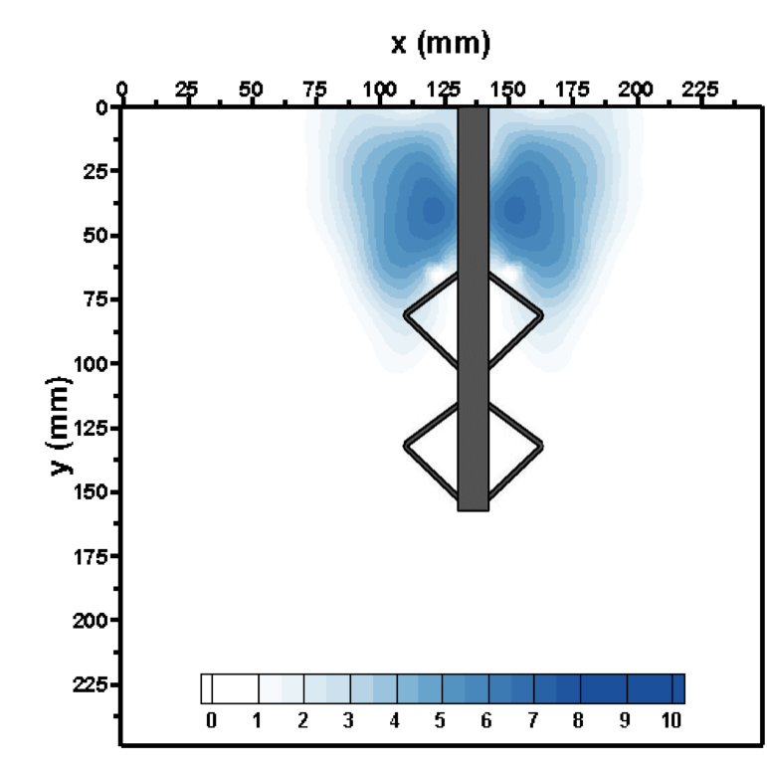
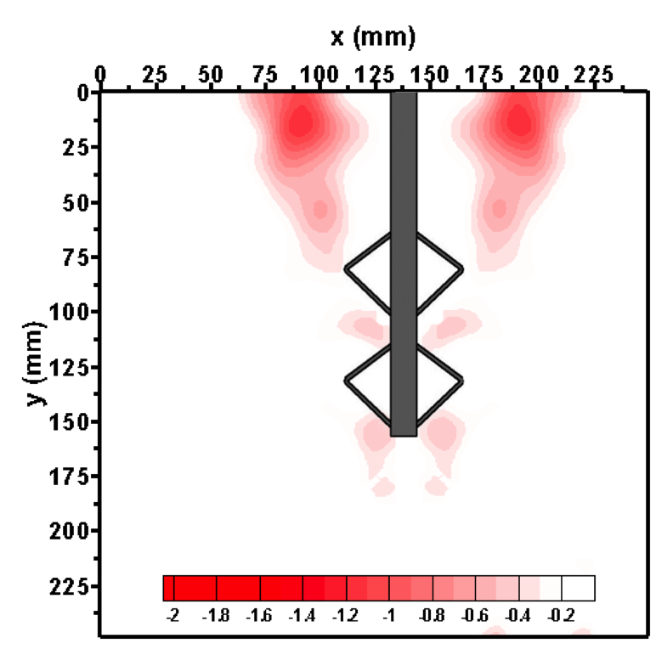
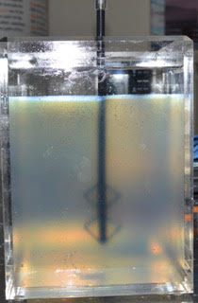
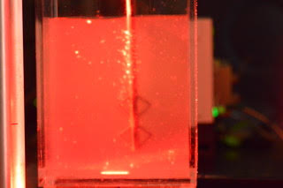
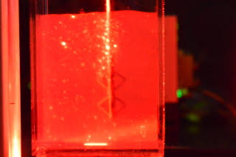
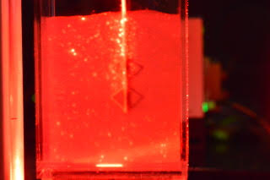
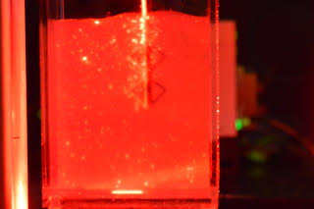
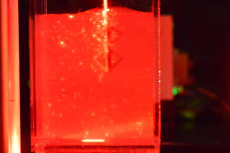
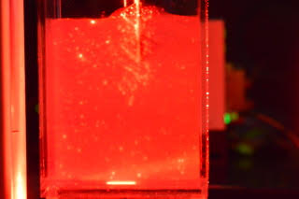

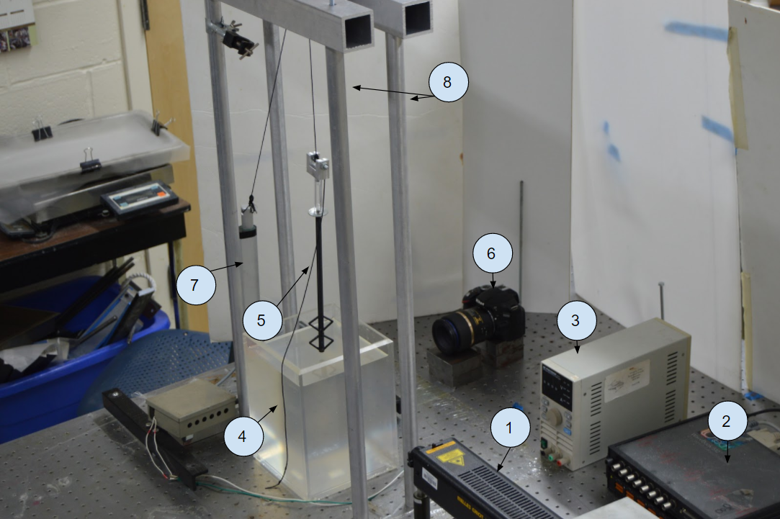


Understanding the mechanisms behind TFEG smart piles
Tandon School of Engineering
Faculty: Magued Iskander, PhD, PE, F.ASCE Mentors: Abdelaziz Ads, Linzhu Li And Giuseppe Maione By:Marko Henien, Fidelis Izekor
The purpose of this study is to investigate how the fins function and locate the ideal arrangement of fins.
RESULTS
Exploratory strategy
In order to understand the mechanisms behind the new piles we used a relatively new technology called transparent soils. Transparent allow us to see the movement of the soil around the pile as a pile moves upward. The transparent soil is made by combining fused quartz and mineral oil
Photos of Pile Load Test in Transparent Soil Using Laser Sheet
a) Incremental displacement in the Y direction b) Incremental displacement in the X direction
Shaft:-
D:9mm
L:300mm
Fins:-
D:41mm
Material
3D Printing
Plastic
Conclusions
1- The soil was displaced by approximately 25% in the y plane and 5% in the x plane relative to the fins diameter when the length to fins ratio was 3.65
2- The 2 fins acted as one large force rather than 2 independent forces creating 2 large areas of displacement
3- The affected area in displacement extended to 1.5 fins diameter from each side and also take a conical shape .
0s 4s 8s 12s 16s 20s
HeNe Laser
Data acquisition system
Power Supply
Transparent soil
Simutedla TFEG pile
Nikon 90mm 1:2.8 macro lens
LACT8-12V-20 Linear Actuator 8”
Pulley system
References:
Hossain, M.S., Kim, Y. and Gaudin, C., 2014. Experimental investigation of installation and pullout of dynamically penetrating anchors in clay and silt. Journal of Geotechnical and Geoenvironmental Engineering, 140(7), p.04014026.
Guzman. I., Iskander.M, Suescun-Florez. E., and Omidvar. M., 2014, “A Transparent Aqueous Saturated Sand Surrogate for Use in Physical Modeling”. Acta Geotechnical, Vol. 9, No. 2, pp. 187–206.
Liu, J. and Iskander, M., 2004. Adaptive cross correlation for imaging displacements in soils. Journal of computing in civil. engineering, 18(1), pp.46-57
Civil and Urban Engineering

